Slide 1
Irish Deer Management Strategy Group (IDMSG) Presentation to Deer Management Stakeholder Forum
Teddy Cashman
31st August 2023 - Portlaoise

Slide 2
Chair of Irish Deer Management Strategy Group – Teddy Cashman
Welcome
Sub-Committee Review
Main common proposals:
Creation of deer management agency
Establishment of deer management units
Changes to Open Seasons Order

Slide 3
Chair of Irish Deer Management Strategy Group – Teddy Cashman
Short term proposed actions:
Appointment of program manager
Set up a number of DMUs in critical areas
Next Steps
Presentation of report to ministers with top 3 recommendations and to seek funding to get programme up and running
Final Recommendations to be made by Deer Management Strategy Group
Main objective to achieve sustainable deer densities throughout the Country

Slide 4
Recommendations from Legislation Sub Group - Padraig Comerford
Erig Conway - Irish Deer Society; Hugh Farrell – Irish Cattle and Sheep Farmers Association; John Flannery – National Association of Regional Game Councils; Ronan Gorman - Country Sport Ireland; Damien Hannigan - Irish Deer Commission; Gary Healy – Coillte; Des Morrison – Irish Creamery Milk Suppliers Association; James O’Keeffe – DAFM; Declan O’Neill - Wicklow Uplands Council; Padraig O’Tuama - Pro Silva Ireland; Joachim Schaefer - Sporting Rights Owners Association Ireland; Claire Crowley – N.P.W.S; Adam de Hóra – NPWS Secretary.
Padraig Comerford NPWS Chair
Open season for male deer should be amended to 1st August to 30th April annually. Majority
Open season for female deer should be amended to 1st October to 31st March annually, but some of the committee recognises that there could be issue with October for animal welfare reasons and further discussion may be needed. Majority by 1.
More staff should be assigned to the NPWS licensing unit and Regional Management, to effectively and efficiently process section 42 applications so that license applications are processed within 15 working days. Unanimous

Slide 5
Recommendations from Legislation Sub Group - Padraig Comerford
S42 (1) of the Wildlife Act should be amended to expand the circumstance which can trigger an application for section 42
For animal health and disease management e.g. TB in cattle
To control damage to a conservation or important biodiversity area
For road traffic safety. Majority
There should be more flexibility regarding the conditions imposed when issuing S42 licences
There should be no restriction on the numbers of deer to be shot except for red deer in Kerry. Majority
Artificial callers, thermal imaging spotting devices, thermal/nigh vision telescopes, use of lamps at night and shooting from mechanically propelled vehicles should all be allowed under licence. Majority
Section 42 applications from groups should be allowed e.g. from an entire DMU. Unanimous
SI 239 of 1977 should be amended so that the minimum calibre for shooting deer is a .243 rifle with a minimum bullet weighing not less than 100 grains. (Users will likely want a reasonable notice before this change) Unanimous

Slide 6
Recommendations from Legislation Sub Group - Padraig Comerford
SI number 22/2020 S(3)(d)(i) and (ii) and 4(b)(i) and (ii) should be amended so that there is no limit on the number of wild deer or deer meat that can be supplied by a hunter to the final consumer or retail establishments in a year. Unanimous
Uneconomic deer and deer pluck should be removed from lands to avoid animal health and welfare issues. These could be picked up by a knackery with the involvement of Department of Agriculture, Food and the Marine. Unanimous
NPWS and Coillte as large landowners should change their policy to ensure more active control of deer in their properties including fencing in order to ensure sustainable numbers. Unanimous
Deer culls in problem areas should be incentivised by payments. Deer management groups need adequate resources in order to help achieve sustainable deer numbers. Unanimous
This group recommends that the model used in Wicklow Deer Management Project be rolled out to other TB Black Spots Nationally Unanimous

Slide 7
Recommendations from Legislation Sub Group - Padraig Comerford
This group is aware of the firearms expert committee recommendations to the Department of Justice on a wide range of firearms matters and believes that anything proposed by that committee should be consistent with and enable more effective deer management Unanimous
All the recommendations and initiatives from all groups should be linked to the environmental, biodiversity and animal welfare necessity so that it is clear to a wider audience the absolute necessity to achieve sustainable deer numbers. Unanimous

Slide 8
Recommendations from Training & Education Sub Group – John Casey
Sub group members:
Erin Furlong - Coillte; TJ Maher - IFA; Jim Walsh – Veterinary Surgeon; Craig McCleane - Irish Country Sports Assoc.; Capt. Neil Forde - Irish Deer Society; Ronan Gorman - Country Sports Ireland; Danny O’Keeffe - NPWS; Pat Dunne - Wicklow Uplands Council; Declan Carroll - DAFM; John Butler - NARCG; David Dunne - Wild Deer Assoc. of Ireland; Liam Nolan - Deer Alliance; John Casey - Teagasc.
Format: One in person meeting, questionnaire, followed by 3 meetings via zoom
Notes:
I would like to express my personal thanks to the members of the subgroup for the giving of their time & valuable knowledge, as well as their active participation in discussions and the finalisation of the recommendations.

Slide 9
Recommendations from Training & Education Sub Group – John Casey
Training & education in deer management issues for members of statutory bodies
Notes:
i.e. NPWS staff dealing with deer, Forest Service inspectors & DAFM personnel, Coillte, Teagasc advisors and private forestry & farm advisors. Persons tasked with contributing to and providing oversight of deer management plans require at a minimum a basic knowledge of deer monitoring and management.

Slide 10
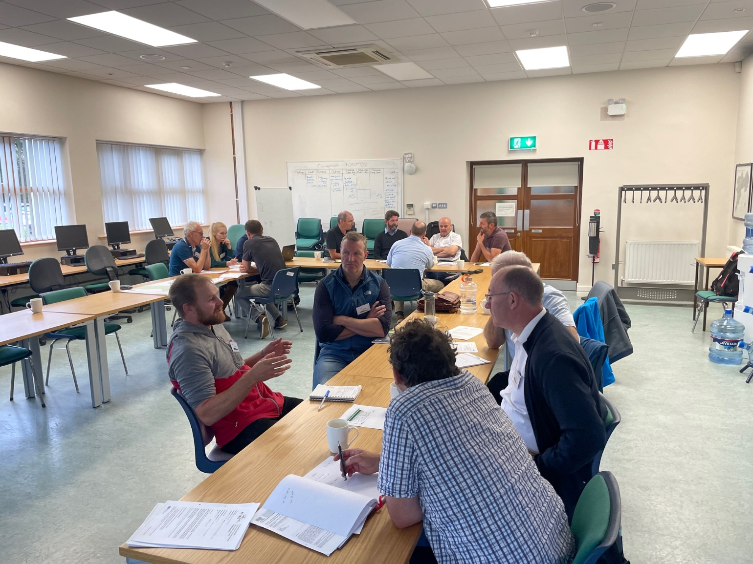
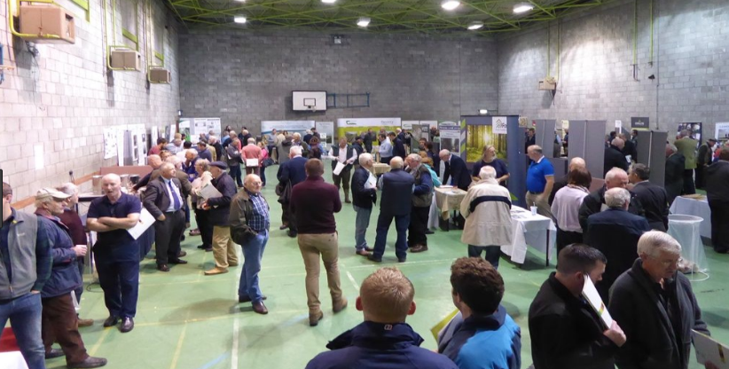
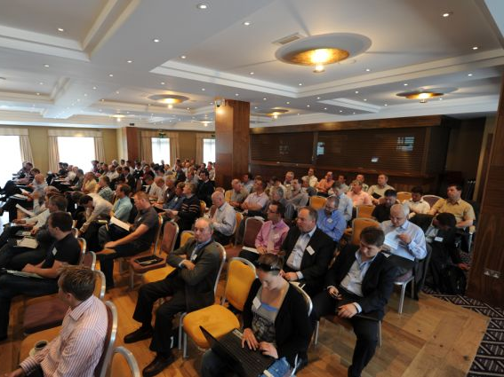
Recommendations from Training & Education Sub Group – John Casey
Local engagement between landowners & hunters, in the form of seminars/ meetings
Notes:
Seminars/ meetings, initially located in “hot spot” catchments, are recommended to build knowledge and capacity for both stakeholder communities.
An emphasis on a localised response and the need for all major landowners in an area to actively engage will be fundamental to any proposed Deer Management Unit (DMU) structure.

Slide 11
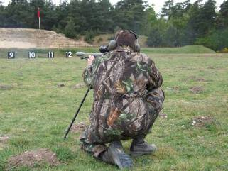
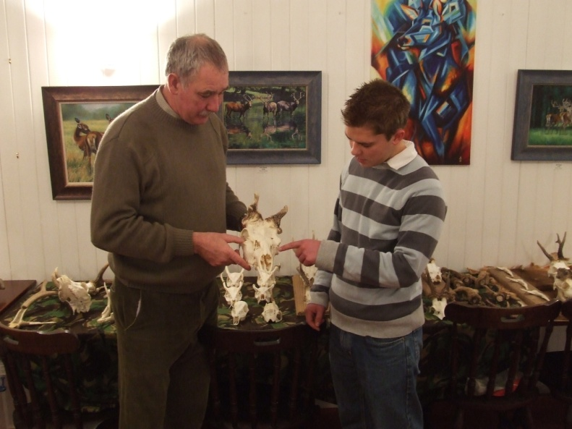
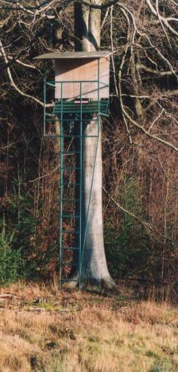
Recommendations from Training & Education Sub Group – John Casey
Introduction of a basic competency test for all hunters within 3 to 5 years.
Notes:
There is a broad acceptance that there is sufficient capacity amongst the training providers to cater for entry level training now and if demand increased.
A basic competency test is recognised as an integral part of training and it is recommended that it should include the phased certification of all hunters to take place within the next 3- 5 years.

Slide 12
Recommendations from Training & Education Sub Group – John Casey
Establishment of an oversight & accreditation committee for hunter training to promote
- common syllabus
- best practice guidelines
- standards accreditation
Notes:
Hunter training should adhere to a common syllabus & best practice guidelines, regardless of the provider(s).
Standards accreditation, especially for more intensive training, is considered necessary and it is recommended that an oversight & accreditation committee be established as part of any future Deer Management Strategy Group structure.

Slide 13
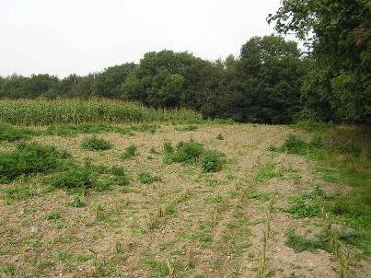
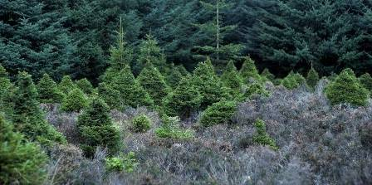
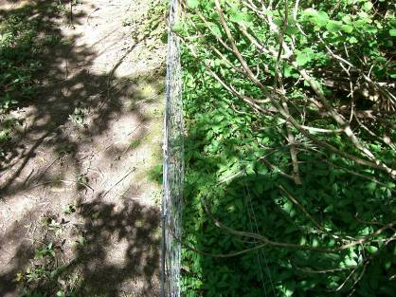
Recommendations from Training & Education Sub Group – John Casey
Integration of a deer management module into land-based educational courses-
agricultural, forestry, land management, environmental
Inclusion of deer management in Continuous Professional Development (CPD) programmes
Notes:
The integration of a deer management module into agricultural, forestry, land management & environmental – focussed primary degree courses is strongly recommended.
Forest design in particular is seen as critical to any long term management of the deer population. Deer management should also be included in relevant continuous professional development programmes.

Slide 14
Recommendations from Collaboration Sub Group – Ken Sweeney
Overarching Structure: An Agency or Unit is required with the responsibility for Deer management in Ireland. This agency will need to be staffed by people with experience in Deer Management to measure impacts or deer populations and work with stakeholders. A success measurement will be needed. Monitoring outputs and results is critical to measuring the success of any plan or policy. This agency will need to be properly resourced with a statutory footing outside of DAFM.
Cooperation: Deer Management Units (DMU) with land owners and hunters working together to create a plan to manage deer within a specific area will be required going forward. A strong person with deer management experience within a DMU will be needed to manage and lead a DMU. DMU’s should collaborate with the agency outlined above.

Slide 15
Recommendations from Collaboration Sub Group – Ken Sweeney
Incentives: Due to the price paid for Venison a bounty or minimum price structure should be introduced to incentivise hunters to manage numbers effectively.
The open season should be reviewed. It is recommended that the season be extended to the end of March for Hinds.
Coillte should remove cull numbers from licences to reduce financial competition at tender stage based on the cull number attached to the licence.
Data Sharing: All stakeholders that store or use data in relation to Deer hunting should have access to one central platform or hub where data is stored. This could be managed by the agency or unit with the responsibility for deer management in Ireland. The data required will need to be clear and defined and it should be as basic as possible.

Slide 16
Recommendations from Solutions for Land Mgt. Sub Group – Seppi Höna
Subgroup Members:
Joe Gowran - Woodlands of Ireland; Sean Eustace - Irish Forest Owners; Amanda Mooney – IFA; Dermot Houlihan – AIFC; Ashley Glover - Irish Deer Commission; Joe Morrisey - Wicklow Uplands Council; Carl McDermott - Wild Deer Association of Ireland; Paddy Purser - Pro Silva Ireland; Dr Tim Burkitt - Deer Biologist; Richard Coghlan – NARGC; Fionnuala Tyrell – INHFA; Andrew Kirwan – DAFM; Sam Birch – NPWS; Chris Fox – ICMSA; Karen Woods - Coillte
Group met 4 times
Agreed 5 topics to address solutions for land management challenges
Open Seasons, Deer management on state/semi-state lands, Incentives for landowners, Incentives for Forest Owners & Data/Impact assessments

Slide 17
Recommendations from Solutions for Land Mgt. Sub Group – Seppi Höna
Open Seasons
Change of open season order for Fallow/Red/Sika Deer – Revise open season (inclusive dates)
Male – 1/8 – 31/12
Female – 1/9 – 31/3
Revised Section 42 procedures – Simplify issuing of Sec 42 licences by NPWS. Crop damage including tree and grassland damage should allow landowner act in advance of Sec 42 application if damage is ongoing.

Slide 18
Recommendations from Solutions for Land Mgt. Sub Group – Seppi Höna
Deer Management on State/Semi-State lands
State and semi-state landowners must by law complete a deer management plan every 3 – 5 years.
Oversight on the implementation of these management plans must fall to an independent regulatory body tasked with all deer related issues in Ireland.
Develop a national deer management framework that all landowners must work towards to ensure landscape level sustainable deer numbers that do not negatively impact on land use objectives or biodiversity goals.
State and semi-state agencies to take the lead on developing and implementing delivery focused deer management with nationally agreed objectives. It is widely accepted that without appropriate deer management on state and semi-state lands, successful delivery of deer management at a wider landscape level is not possible in Ireland.

Slide 19
Recommendations from Solutions for Land Mgt. Sub Group – Seppi Höna
Incentives for landowners/Forest Management Incentives
Compensatory renumeration for delivery of whole carcasses to designated facility.
Permitted use (without need for additional licence) of thermal imagery equipment for culling & for visual identification.
Development of agri-environmental scheme with a focus on deer management including the development of deer management units (DMUs) in conjunction with external facilitators.
To reduce risk of spread of disease, measures to facilitate the appropriate disposal of offal.
Developing a deer fencing standard, providing training to contractors and have a deer fencing contractor database.
Adjusting deer fencing costs in line with actual costs.
Developing grant aid for development of deer management plans (should also be made available to state/semi-state agencies)
Grant aid for deer management facilities such as high seats/management of deer open areas.
Revise forest design requirements to facilitate deer management. Open areas and features should be paid for as part of any grant scheme. Deer management planning and data collection and analysis can act as delivery mechanism to achieve positive results.

Slide 20
Recommendations from Solutions for Land Mgt. Sub Group – Seppi Höna
Data/Impact assessments
Development of a standardised approach for assessing deer impacts in forestry, agriculture (including grasslands)and for priority habitats.
Development of a national standard on deer population assessment techniques. This should look at best practice internationally including the use of trail cameras, Infrared cameras including drone technology, visual counting methods and the use of conventional faecal pellet counts.
State agency to take lead on developing standards and collecting/managing data.

Slide 21
Recommendations from Venison Sub Group – David Quinn

Slide 22
Recommendations from Venison Sub Group – David Quinn
Sub Group Members:
David Quinn – DAFM; Ferdia Marnell – NPWS; Jim Walsh - Veterinary Surgeon; Pat Doyle - Wild Irish Game; Donal O’Mahony – DAFM; Paul Fletcher - Premier Game; Peter Windsor - Irish Deer Society; Ger O’Brien - Wild Deer Association of Ireland; Tina Durkin and James Ruane - JJ Game Dealing; Conal Colleary - Sligo Co. Co.; Momme Reibech – DAFM; Stephen Buckley - FX Buckley Restaurants and Butchers; Emmet Doyle - Bord Bia; Adrian Cummins - RAI

Slide 23
Recommendations from Venison Sub Group – David Quinn

Slide 24
Recommendations from Venison Sub Group – David Quinn

Slide 25
Recommendations from Venison Sub Group – David Quinn

Slide 26
Recommendations from Venison Sub Group – David Quinn

Slide 27
Outline of Legal Timeframes Claire Crowley
Statutory Instruments (S.I.) Process
Policy decision made and communicated to Legislation Unit
Initial S.I. drafted by the Unit & manage process
Draft sent to the Office of the Parliamentary Counsel (OPC)
OPC considers draft and may make drafting corrections or raise policy/legal considerations
Final draft submitted to Minister for signature
S.I. laid before the Oireachtas
S.I. Published on statute book & communicated
Timeline
Two to six months
Risks to delay – capacity issues with OPC or legal issue identified

Slide 28
Outline of Legal Timeframes Claire Crowley
Primary Legislation Process e.g. Wildlife Acts
Exact policy decisions made and communicated to Legislation Unit
Memo for Government drafted and circulated to other Departments
Heads of Bill drafted by Unit
Unit engages with Data Protection Commissioner, where necessary
Seek Cabinet approval
Publish Heads of Bill
Engage with OPC to draft Bill
Full Public Consultation
Pre-legislative Scrutiny
Finalise draft with OPC
5 stages through both Dáil & Seanad
Signed by President
Timeline
Minimum of 18 months from start to finish

Slide 29
Questions & Answers

Slide 30
Close &
Thank you

